Slide 1
Rajasthan Hackathon
On the Occation of IT-Day Celebration
To Have A New Revolution
Platform Applied – e-Mitra
Presenting an Idea
An “IDEA”
- Gaurav Agarwal

Slide 2


? Idea ?
The one who thinks how to implement
an Idea.
One who think to get an Idea to start
a business.

Slide 3

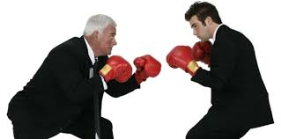

Then who succeed?
The One who have an unique Idea and ability to work on it
Eg An Android developer have came up with Idea of useful
App
Or
The One who have ability(eg money , Technology knowledge)
and guts to implement an Idea which is of other Brain
The one or a team who implement wins and known
to be “ENTERPRENEUR” or “ENTERPRENEURS”

Slide 4

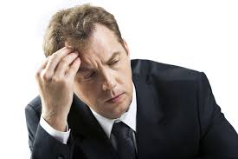
Problem
Not to Share an Idea with Anyone ,what I have to do
Live Your Own life(Fear of stealing ,Lack of Trust)
Fear of dying with jealousy , No recognition of
Yours in spite its your Idea which brought the change
As we Know 90% of Population is selfish(leaving 10% approximately)
“Stopping A overall Change”

Slide 5
SOLUTION
The Solution is to build a Secure System ,Secure and Trustworthy
Connections , We need a platform where
unique Idea
Idea person(who have an idea)
Designer
Developer (or a team of developers)
And Many other(who contributed)
Have recognition in History and be rewarded for their work
whose efforts brought the change in making life of an Individual simpler.
“Aheading Towards Overall Change”

Slide 6



Tips For Implementation
Human Participation for collecting Ideas from Rural areas or from the people who do not have access to technologies.
For this (either we can make learn technology to an individual or have a
separate Idea box similar to postbox)
Having a database and search engine where unique Idea & people
related to it can be recognized .

Slide 7

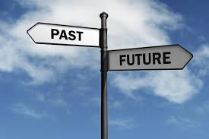

MOTTO or Objective
BRING IN CONNECTIONS
CHANGE IN INDIA
similar to “Make In India”
(Can be extended to world)

Slide 8
Stand Alone To Stand Apart

Slide 9
Thank you

